Slide 1
Regularized
Logistic Regression
Homework - 4 (Group 5)
Machine Learning CSI 6160
Charmi Shah
Riya Singh

Slide 2
Comparison with Linear Regression
Linear Regression could help us predict the student’s test score on a scale of 0 - 100. Linear regression predictions are continuous (numbers in a range).
Logistic Regression could help use predict whether the student passed or failed. Logistic regression predictions are discrete (only specific values or categories are allowed). We can also view probability scores underlying the model’s classifications.

Slide 3
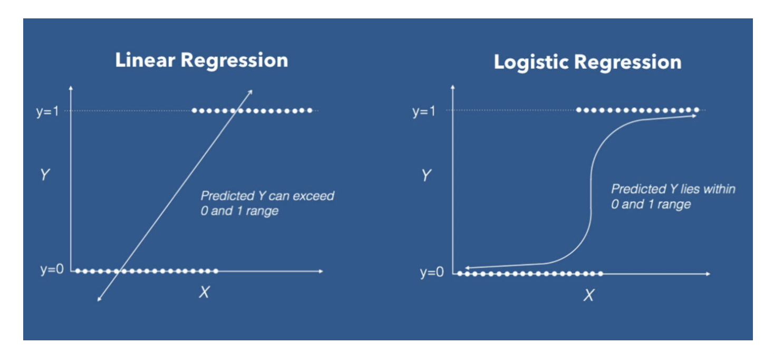
Introduction to Logistic regression
Logistic Regression is a Machine Learning algorithm which is used for the classification problems
We can call a Logistic Regression a Linear Regression model but the Logistic Regression uses a more complex cost function - Which is called a Sigmoid Function

Slide 4
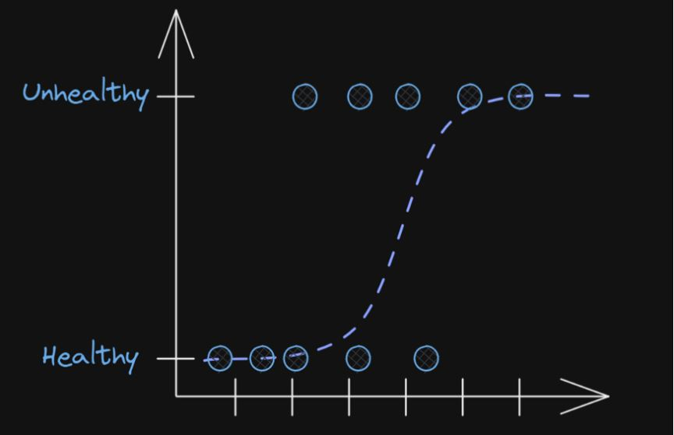
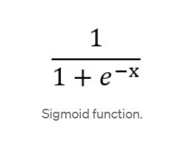
Sigmoid Function
In order to map predicted values to probabilities, we use the sigmoid function. The function maps any real value into another value between 0 and 1. In machine learning, we use sigmoid to map predictions to probabilities.
Math

Slide 5
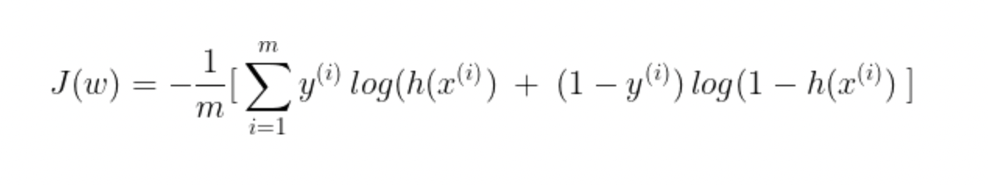
Cost Function
We can predict the probability for an observation, we want the result to have the minimum error.
The objective of logistic regression is to find params w so that J is minimum.
If the class label is y, the cost (error) associated with an observation x

Slide 6
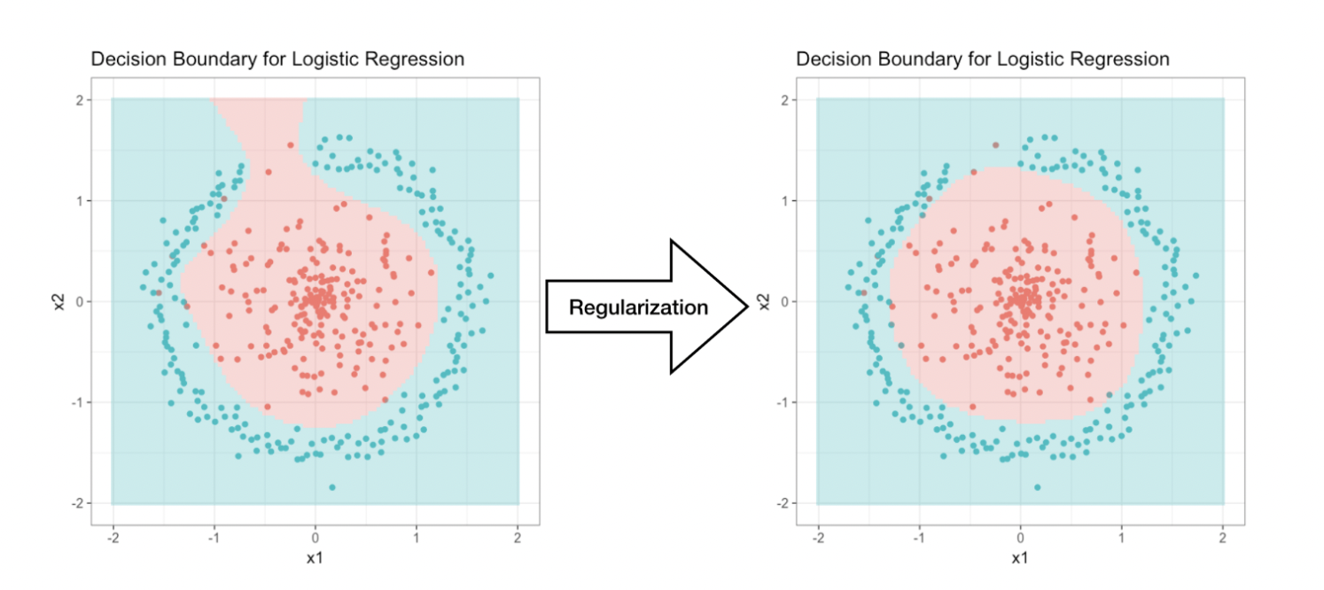
Understanding Regularization in Logistic Regression
In the diagram, two features explained (x1, x2) and the decision boundary is a straight line on a 2D coordinate.
More dataset- more features- more decision boundary complicated.
Overfitting is a modeling error.
To overcome -
Remove less useful features
Use Regularization

Slide 7
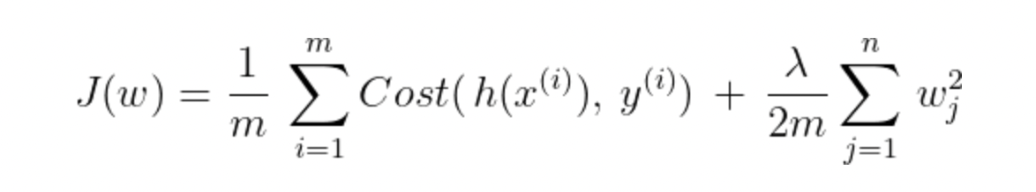
Regularized Cost Function
λ is called the regularization parameter. It controls the trade-off between two goals:
fitting the training data well vs keeping the params small to avoid overfitting.
λ is a hyper-parameter value. We have to find it using cross-validation.
Larger value λ of will make wᵢ shrink closer to 0, which might lead to underfitting.
λ = 0, will have no regularization effect.

Slide 8
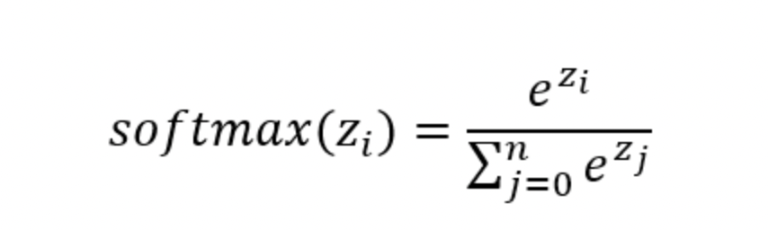

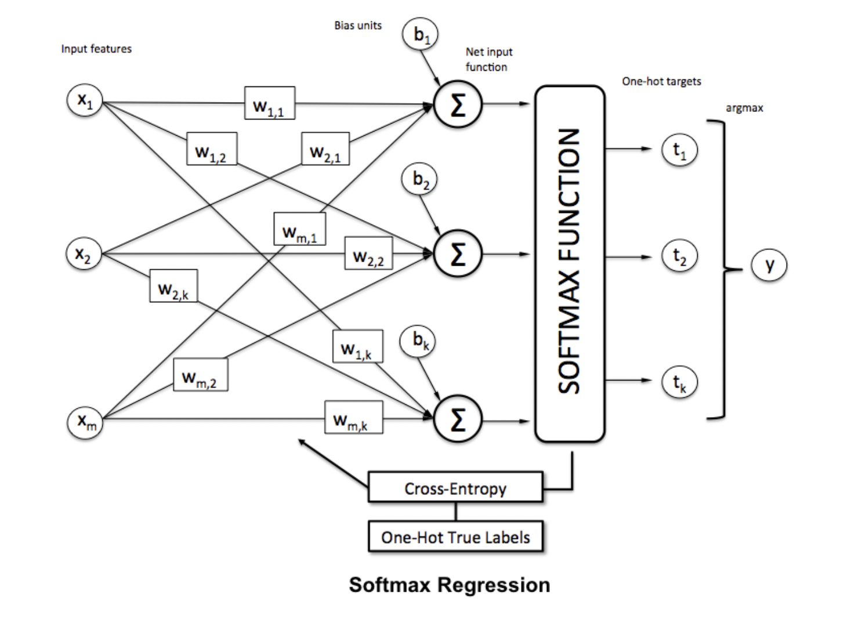
Multi-class Classification
w is the weight vector,
x is the feature vector of 1 training sample
w0 is the bias unit.
This softmax function computes the probability that this training sample x(i) belongs to class j given the weight and net input z(i)

Slide 9
References
https://towardsdatascience.com/understanding-regularization-in-machine-learning-5a0369ac73b9
https://towardsdatascience.com/introduction-to-logistic-regression-66248243c148
https://www.kdnuggets.com/2016/07/softmax-regression-related-logistic-regression.html

